Slide 1
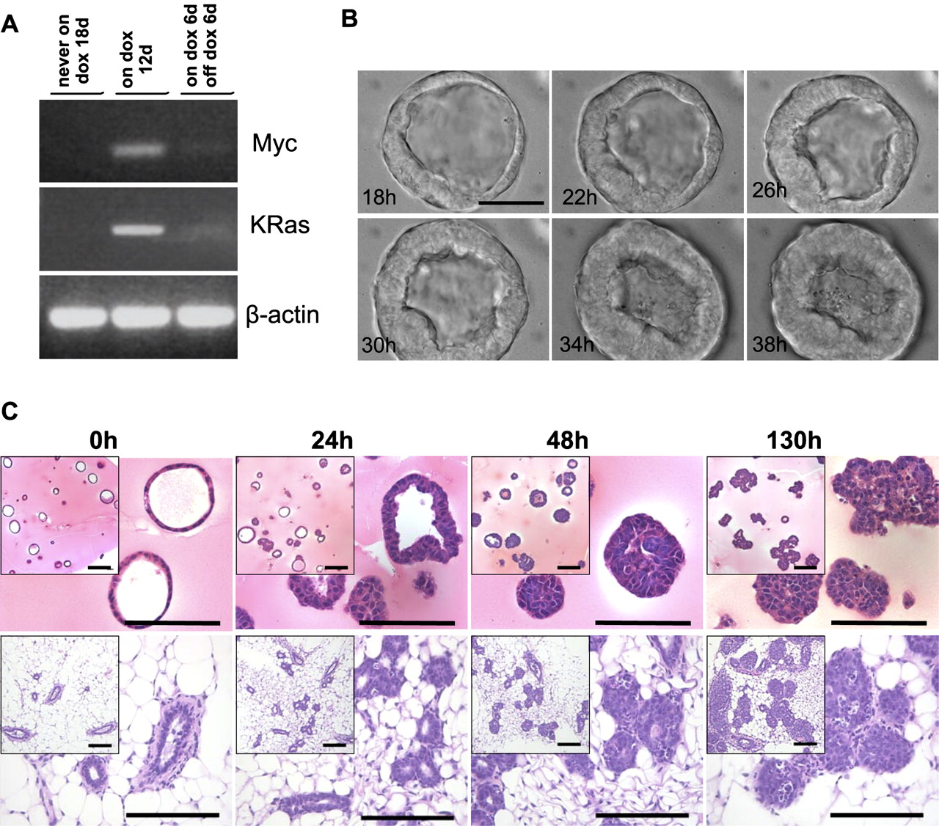

Myc and KrasG12D are regulated in response to doxycycline in 3D gels, and expression is associated with conversion of a hollow acinus to a solid sphere.
Jechlinger M et al. Genes Dev. 2009;23:1677-1688
©2009 by Cold Spring Harbor Laboratory Press
Notes:
Myc and KrasG12D are regulated in response to doxycycline in 3D gels, and expression is associated with conversion of a hollow acinus to a solid sphere. (A) RT–PCR for transgene-specific MYC and KrasG12D expression. RNA was harvested from cells that were obtained from mammary glands of 6- to 9-wk-old, virgin, doxycycline-naïve TetO-MYC;TetO-KrasG12D;MMTV-rtTA mice (tritransgenic cells). (First lane) Tritransgenic cells grown in the absence of doxycycline for 18 d. (Second lane) Tritransgenic cells grown 6 d in the absence of doxycycline and subsequently in the presence of doxycycline for 12 d. (Third lane) Tritransgenic cells were grown 6 d in the absence of doxycycline, subsequently in the presence of doxycycline for 6 d, and finally in the absence of doxycycline for 6 d. (Top panel) Analyses for MYC-specific gene product. (Middle panel) Analyses for KrasG12D-specific gene product. (Bottom panel) β-actin control. (B) Pictures taken every 15 min using a bright-field microscope show a typical acinus grown from tritransgenic cells at indicated time points after doxycycline exposure. Bar, 30 μm. (C) H&E staining on sections for harvested gels containing spheres grown from tritransgenic cells (top panels) and mouse mammary gland biopsies from tritransgenic animals (bottom panels) at indicated time points after exposure to doxycycline. Bars, 50 μm.

